Slide 1
Chapter 11 Analysis of Variance
Notes:
Sometimes, like in t-tests, we want to compare group means (interval level DV)… but where we have more than two groups in the IV (categorical/nominal or ordinal).
The bulk of our sociological questions deal with more than two groups:
we may want to see the influence of ethnic identity (white, black, asian, latino) on church attendance. Has to go beyond two-groups compared
we may want to look at educational attainment for blacks versus whites (including men versus women)… which is now 4 groups: BW,BM,WW,WM
This is why we move beyond the two-sample/independent samples t-test to the more complicated analysis of variance (ANOVA).
ANOVA follows the same steps for hypothesis testing that we used for t-tests (Z-tests)

Slide 2
Research Problem
Want to see how racial categories (black, white, latinx, and other) differ in incomes.
Examining mean differences b/w three (or more) groups

Slide 3
The t-test Way
Recall…
t-Test examines mean differences between two groups
Compares group 1’s mean to group 2’s mean

Slide 4
The t-test Way
To compare means of 3 or more groups, can calculate series of t-tests
each comparing two groups at a time…
Compare Incomes between…
Black vs White
Black vs Latinx
Black vs Other
White vs Latinx
White vs Other
Latinx vs Other
When comparing means for 4 groups, there are 6 total comparisons that need to be done

Slide 5
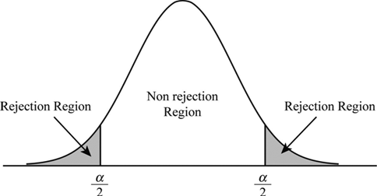
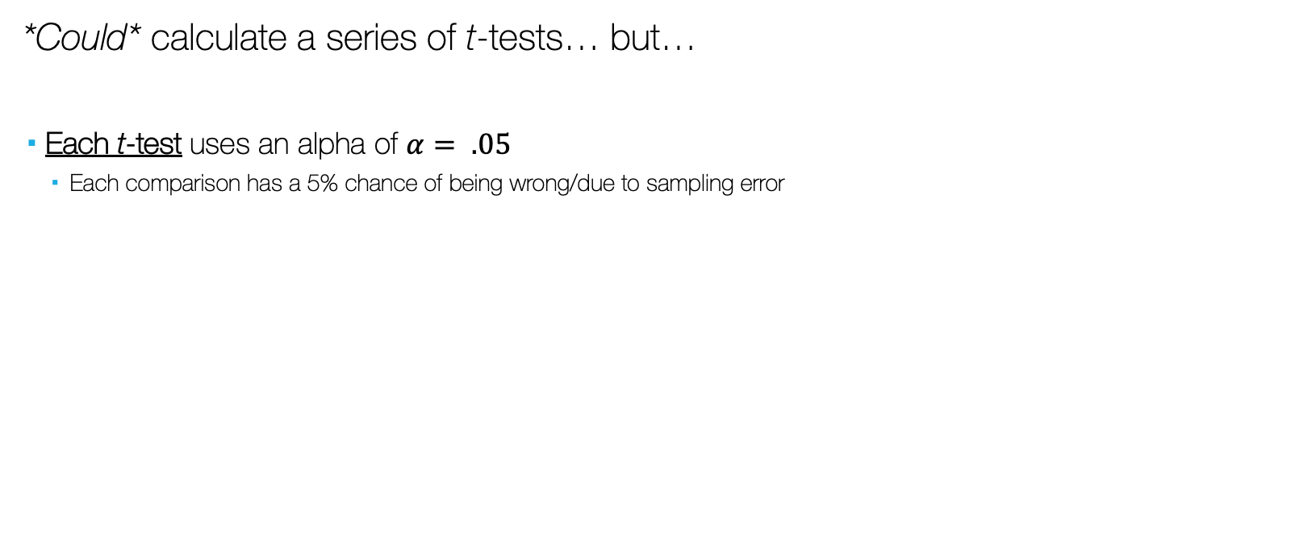

The t-test Way
*Could* calculate a series of t-tests… but…
Each t-test uses an alpha of $α= .05$
Each comparison has a 5% chance of being wrong/due to sampling error
$$α= .05$$

Slide 6




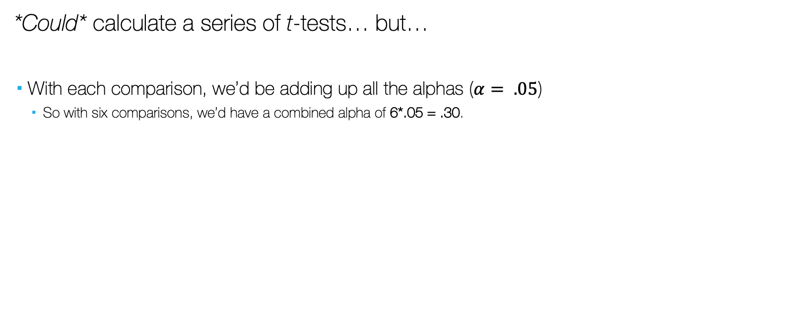
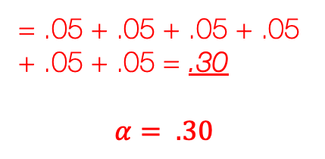


The t-test Way
*Could* calculate a series of t-tests… but…
With each comparison, we’d be adding up all the alphas ($α= .05$)
So with six comparisons, we’d have a combined alpha of 6*.05 = .30.
B v W
B v O
W v O
= .05 + .05 + .05 + .05 + .05 + .05 = .30
$$α= .30$$
$$α= .05$$
$$α= .05$$
$$α= .05$$
B v L
W v L
L v O
$$α= .05$$
$$α= .05$$
$$α= .05$$

Slide 7
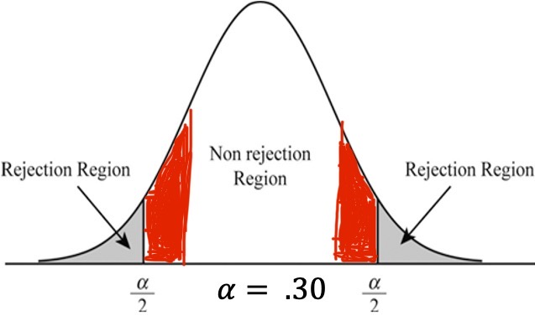
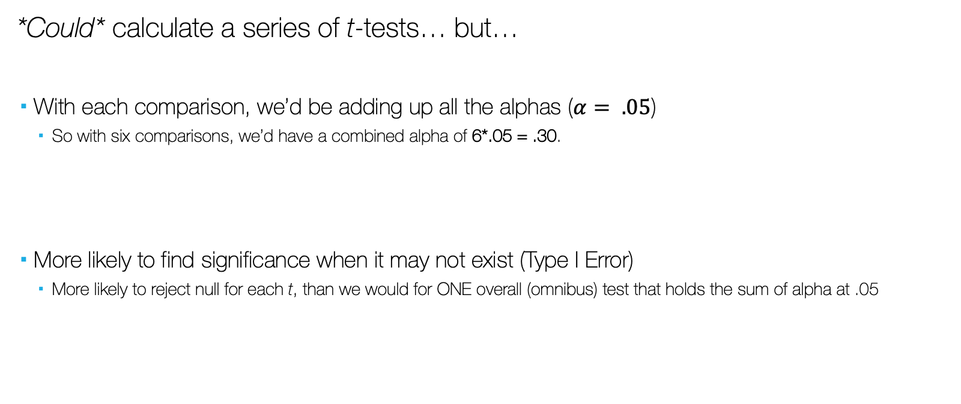
The t-test Way
*Could* calculate a series of t-tests… but…
With each comparison, we’d be adding up all the alphas ($α= .05$)
So with six comparisons, we’d have a combined alpha of 6*.05 = .30.
More likely to find significance when it may not exist (Type I Error)
More likely to reject null for each t, than we would for ONE overall (omnibus) test that holds the sum of alpha at .05

Slide 8

A New Hope
Test that holds alpha constant at $α=$.05, and makes ONE overall comparison
Divides $α=$.05 by the number of comparisons you have

Slide 9
A New Hope
Analysis of Variance

Slide 10
ANOVA (compared to t-test)
Independent Samples T-test (t)
Examines mean differences b/w (compares means of) two groups
Analysis of Variance / ANOVA (F)
Examines mean differences b/w (compares means of) three or more groups
Notes:
Logic of anova is same, but examines variation/difference/variance in numerous means (X1, X2, X3, and X4are all compared), and the null hypothesis isthat all means are equal (mu1 = mu2 = mu3 = mu4).

Slide 11
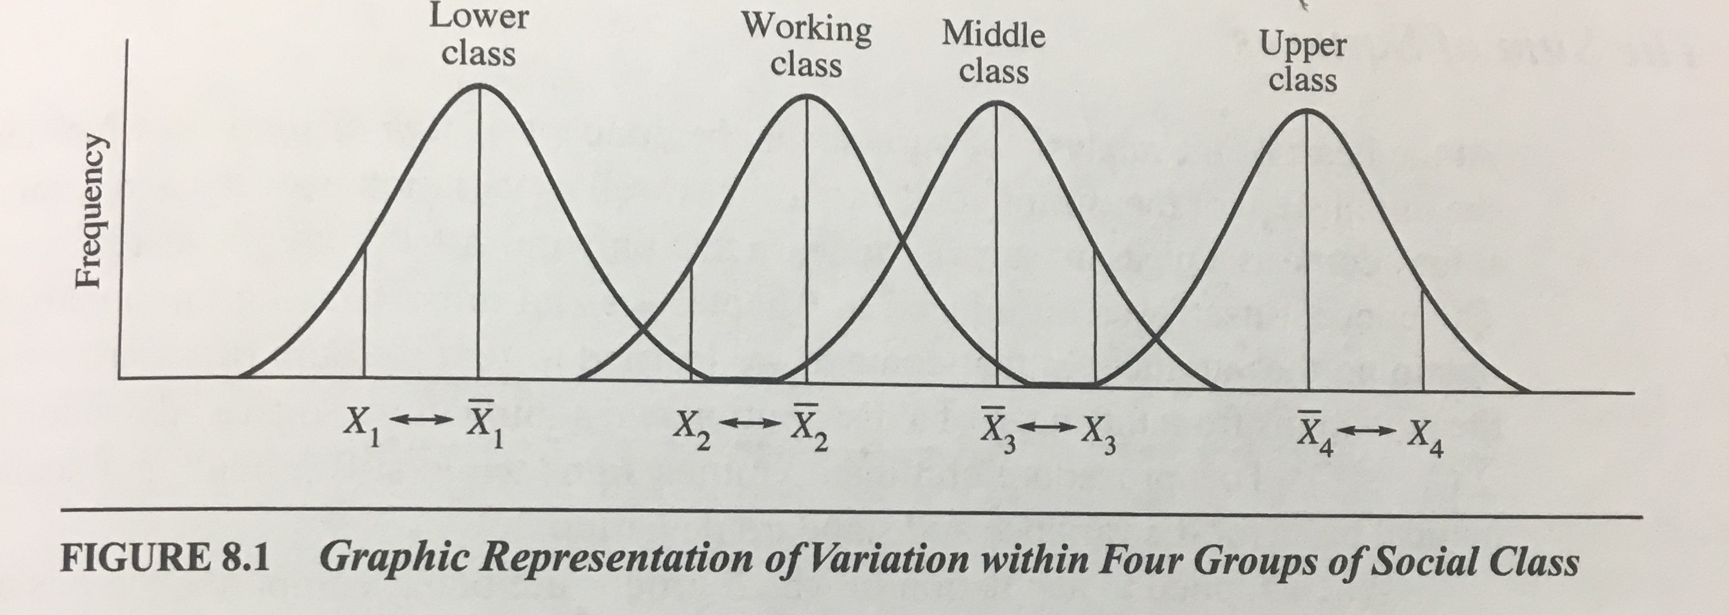
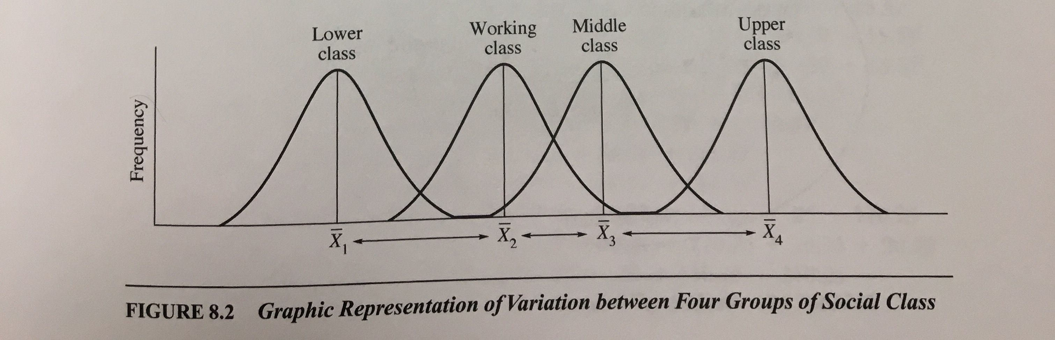
Logic of ANOVA
Total variation across all groups is divisible into two components
Variation between groups
Deviation of group means from one another
Variation within groups
Deviation of raw scores from their group mean

Slide 12
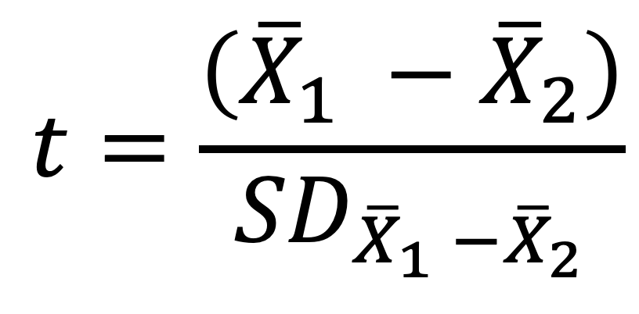
Logic of ANOVA
Just like t-test…
Variation between groups
Deviation of group means from one another
Variation within groups
Deviation of raw scores from their group mean
t indicates the size of the difference between groups relative to the size of the variation within each group
Larger t means there is greater variation between groups, and increase the likelihood of rejecting the null hypothesis
Larger t means extreme group differences, beyond what expected by the null hypothesis
$$t=\frac{\left({\overline{X}}_{1} −{\overline{X}}_{2}\right)}{{SD}_{{\overline{X}}_{1} −{\overline{X}}_{2}}}$$

Slide 13
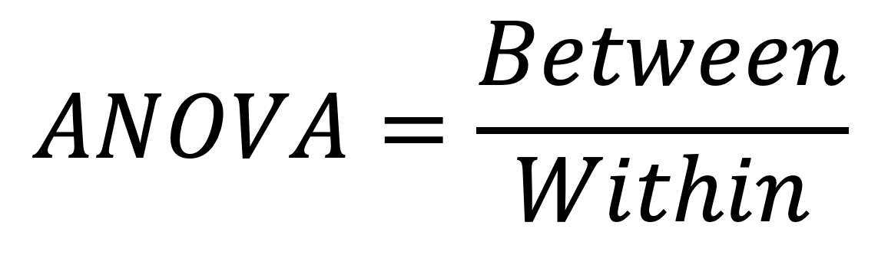
Logic of ANOVA
Much like t-ratio, we’re interested in variation between groups
Variation between groups
Deviation of group means from each other
Variation within groups
Deviation of raw scores from their group mean
$$ANOVA=\frac{Between}{Within}$$

Slide 14
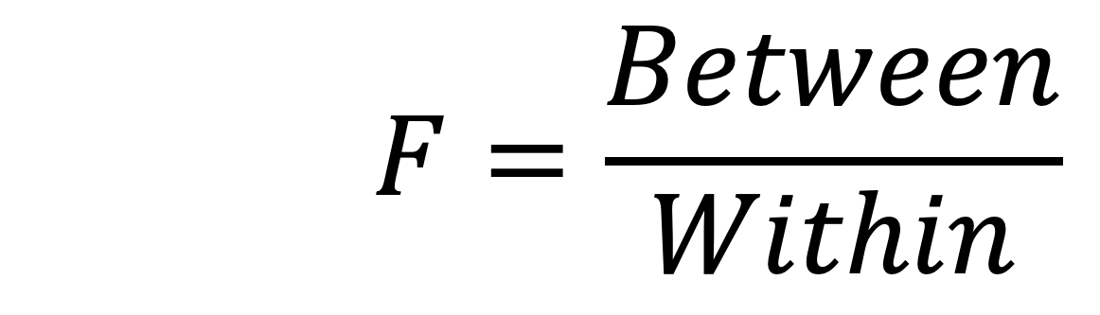
Logic of ANOVA
Much like t-ratio, we’re interested in variation between groups
Variation between groups
Deviation of group means from each other
Variation within groups
Deviation of raw scores from their group mean
F indicates the size of the difference between groups relative to the size of the variation within each group
Larger F means there is greater variation between groups, and increase the likelihood of rejecting the null hypothesis
Larger F means extreme group differences, beyond what expected by the null hypothesis
$$F=\frac{Between}{Within}$$

Slide 15
ANOVA
One-way ANOVA
ANOVA with one dependent and one independent variable

Slide 16
ANOVA (Variable Types)
IV: nominal, ordinal (e.g. categorical/discrete)
Grouping variable
Three or more groups/samples compared
DV: interval-ratio (e.g. continuous)

Slide 17
ANOVA (ASSUMPTIONS)
Independence of Observations
Groups are not related or dependent upon each other. Case can’t be in more than one group. No ties between observations
Equal Sample (Group) Sizes
The number of cases in each group should be relatively similar.
Homogeneity of Variance
Both groups have approximately equal variances (SD²). The distributions (or spread) for the groups are approximately equal. Keppel & Zedeck (1989) suggest that variance comparison should not exceed 10:1 ratio.
Examine variances/SD in summary table of output
Normality of Distribution
Distribution must be relatively normal
Visual inspection using
Histogram
Normality (Q-Q) plots
Box-and-Whiskers plots
If violated, use “unequal variances assumed” formula, otherwise, use “equal variances assumed”
Notes:
If one is violated should be okay. But should make adjustments if necessary.
Don’t have triple whammy (violating final 3 – equal sample sizes, homogeneity of variances, and normality of distribution). You can violate 2 of 3 and still be okay, though.

Slide 18
ANOVA (Hypotheses)
H₀: group means are equal
μ₁ = μ₂ = μ₃ = μ₄ …
H₁: group means are not equal
μ₁ ≠ μ₂ ≠ μ₃ ≠ μ₄ …
Rejecting null means:
there is significant variation in group means
At least one group mean is significantly different than the others
Notes:
Logic of anova is same, but examines variation/difference/variance in numerous means (Y1, Y2, Y3, Y4 are all compared), and the null hypothesis isthat all means are equal (mu1 = mu2 = mu3 = mu4).

Slide 19
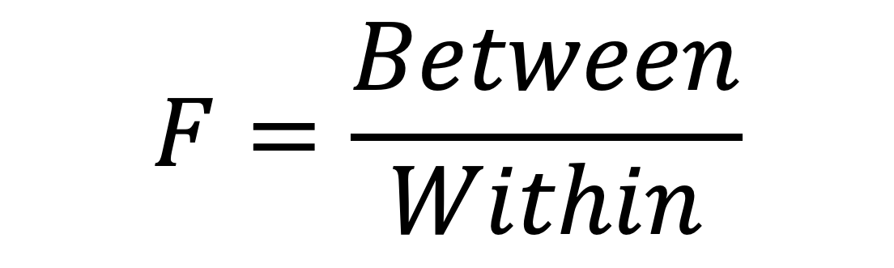
Calculating Anova (F )
To compute variation between and variation within, we use the sum of the squared deviations from the mean (e.g. “Sum of Squares”)
$$F=\frac{Between}{Within}$$
Notes:
Sum of squared deviations from the mean…
Do this for both between group means, and within group means, but also total deviation of raw scores from overall mean

Slide 20
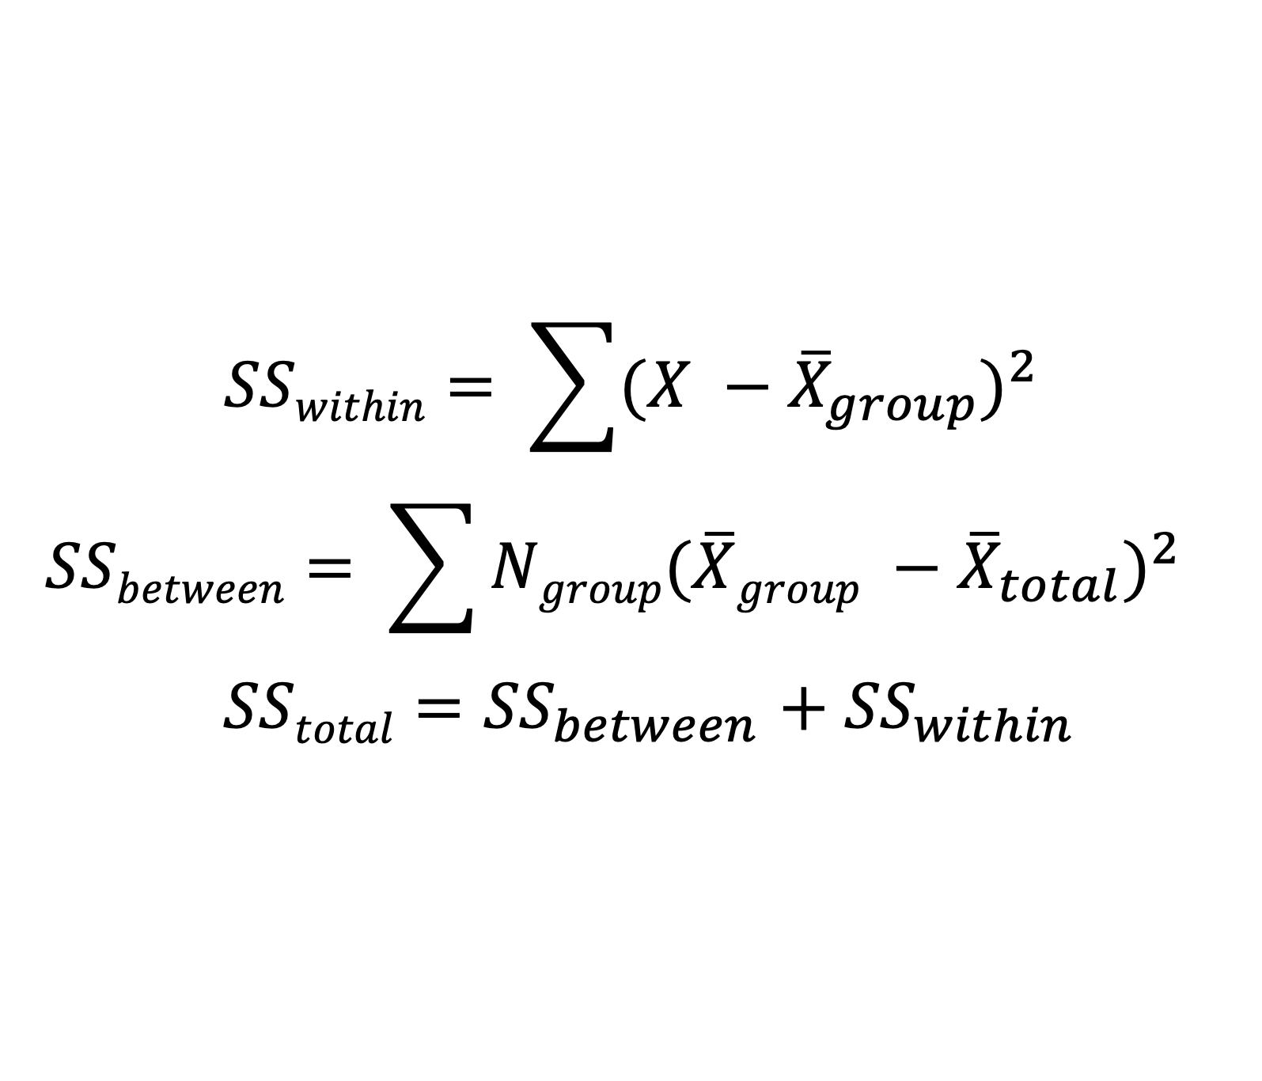
Calculating Anova (F )
$$SSwithin= \sum{{(X −{\overline{X}}_{group})}^{2}}$$
$$SSbetween= \sum{Ngroup{(\overline{X}group −{\overline{X}}_{total})}^{2}}$$
$SStotal={SS}_{between}$ $+ {SS}_{within}$
Notes:
SSW is the sum of squares within, calculated between each individual score and the sample mean.

Slide 21
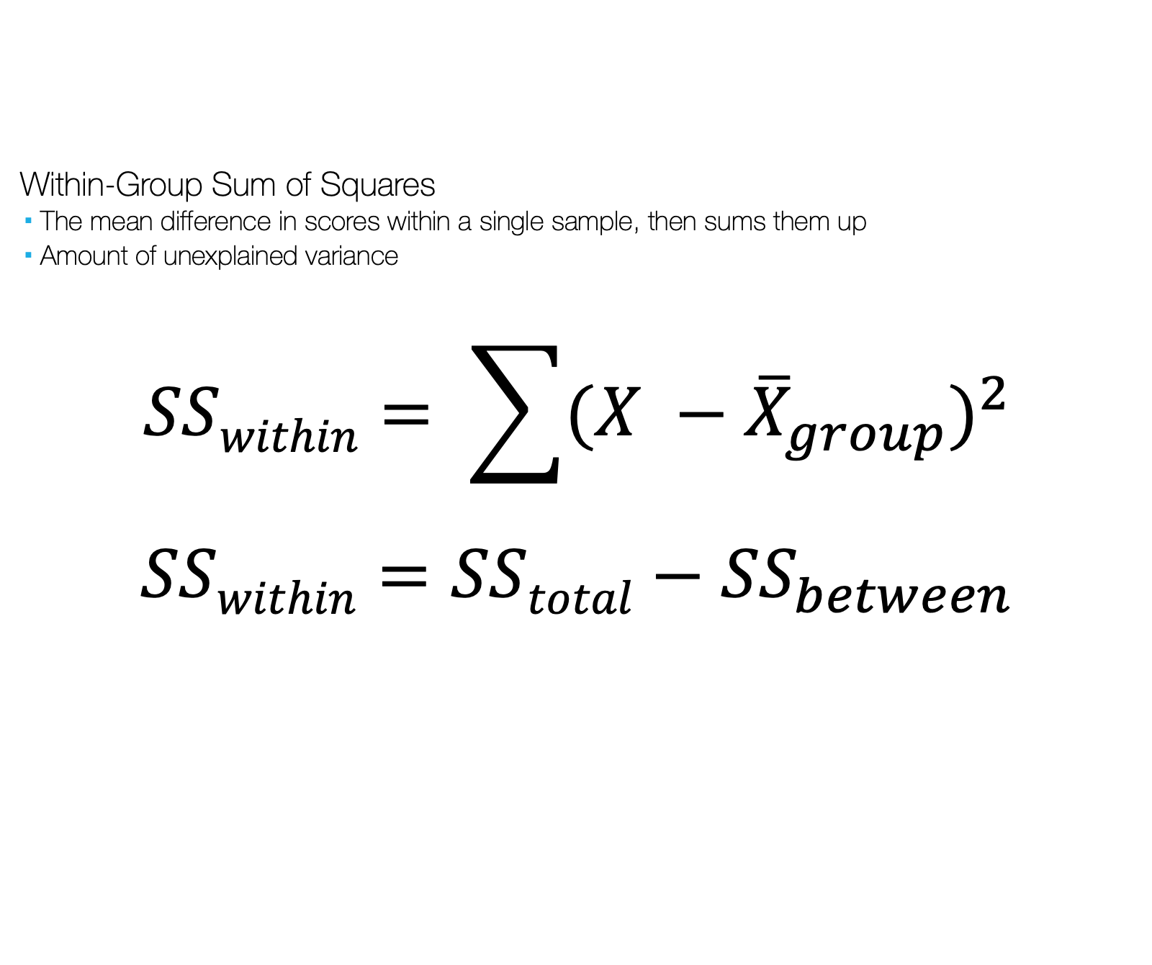
Calculating Anova (F )
Within-Group Sum of Squares
The mean difference in scores within a single sample, then sums them up
Amount of unexplained variance
$$SSwithin= \sum{{(X −{\overline{X}}_{group})}^{2}}$$
$SSwithin=$ $SStotal−{SS}_{between}$
Notes:
SSW is the sum of squares within, calculated between each individual score and the sample mean.

Slide 22
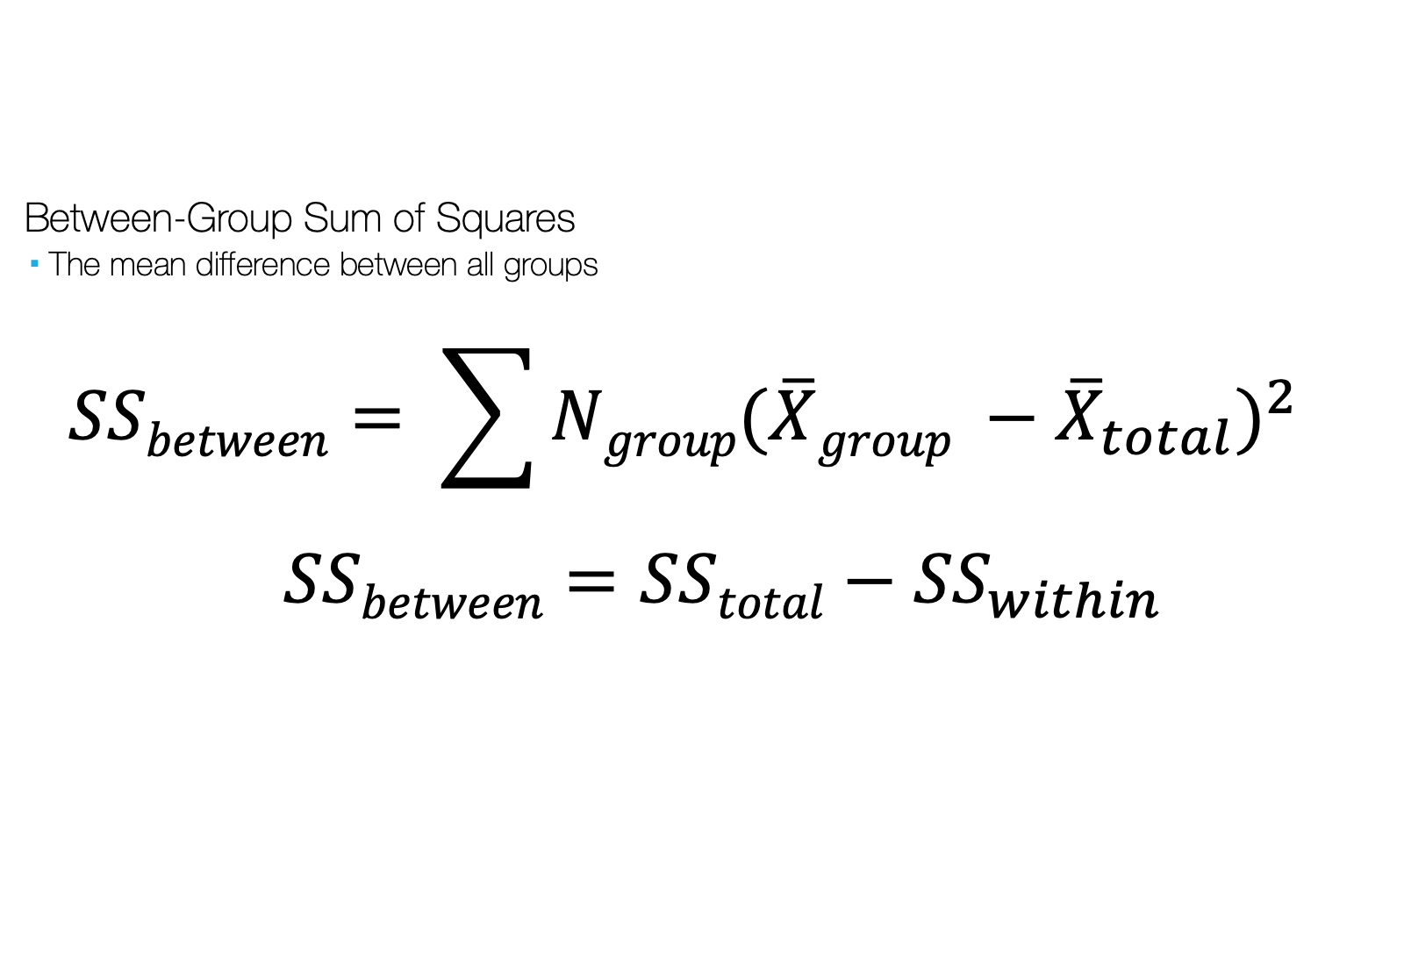
Calculating Anova (F )
Between-Group Sum of Squares
The mean difference between all groups
$$SSbetween= \sum{Ngroup{(\overline{X}group −{\overline{X}}_{total})}^{2}}$$
$SSbetween=$ $SStotal−{SS}_{within}$
Notes:
SSB

Slide 23
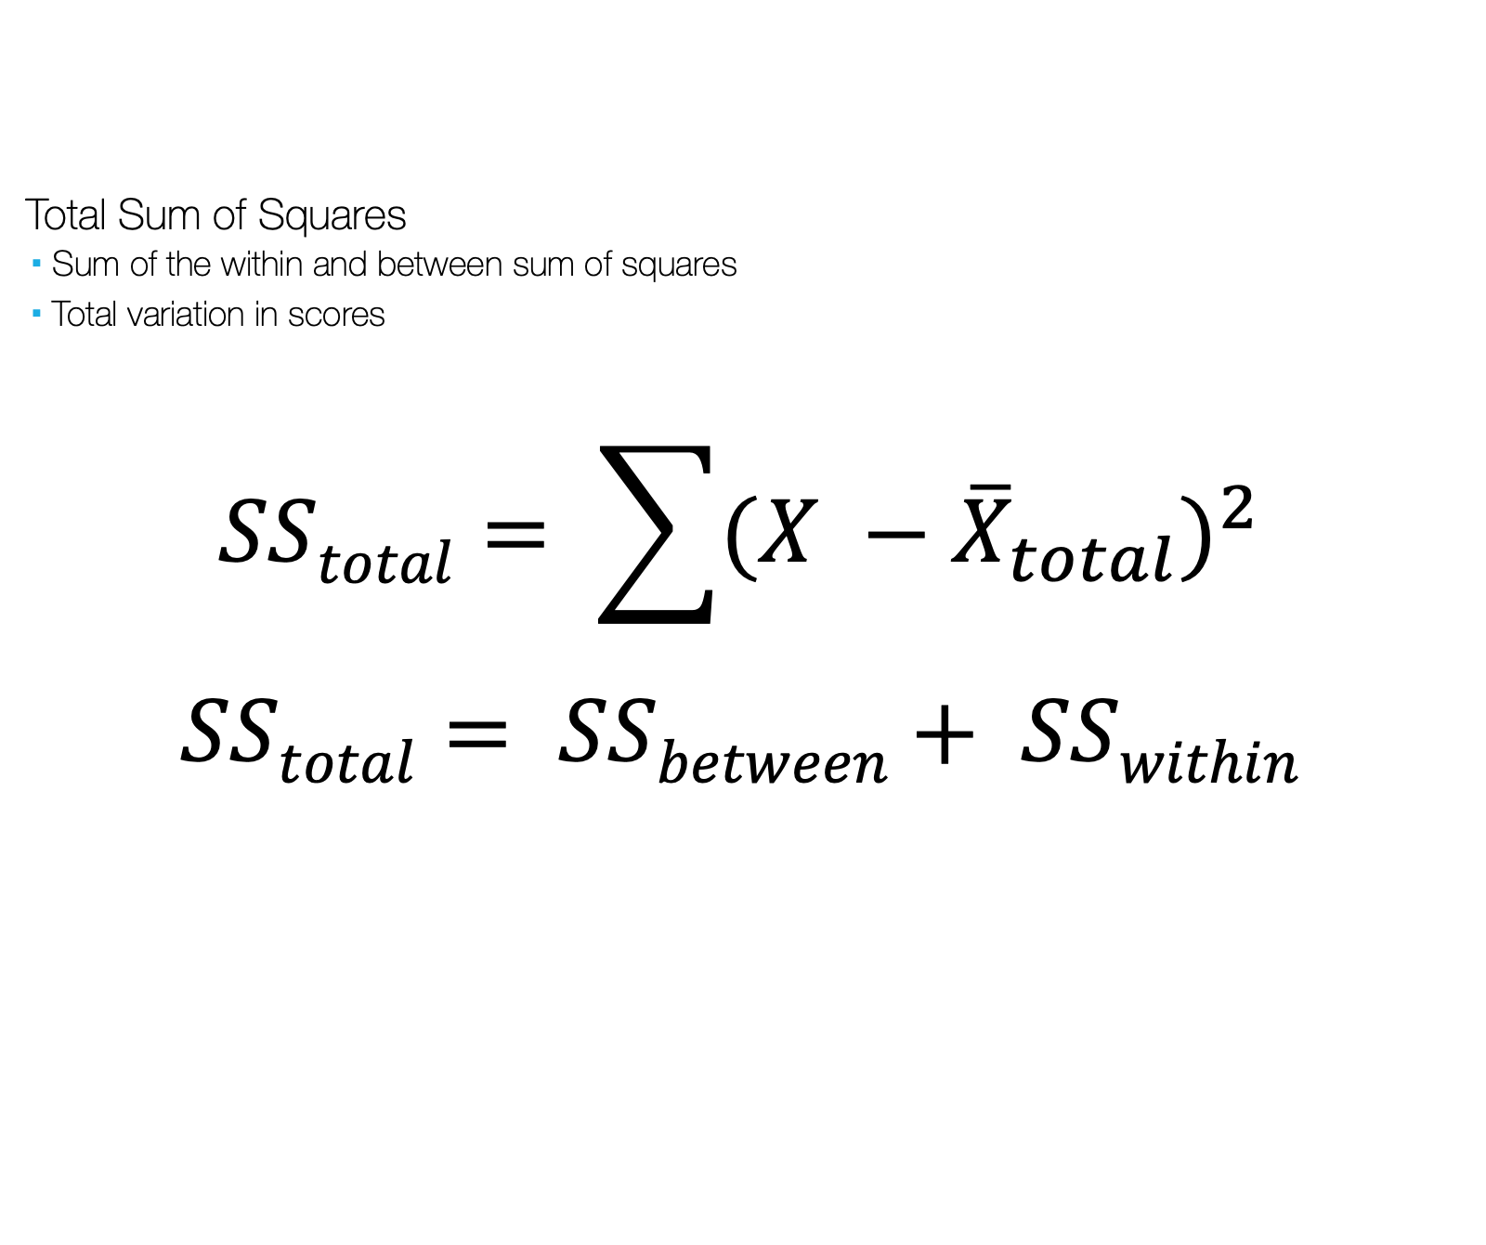
Calculating Anova (F )
Total Sum of Squares
Sum of the within and between sum of squares
Total variation in scores
$$SStotal= \sum{{(X −{\overline{X}}_{total})}^{2}}$$
$$SStotal= SSbetween+ SSwithin$$
Notes:
X_ total also known as the grand mean: mean of all group means

Slide 24
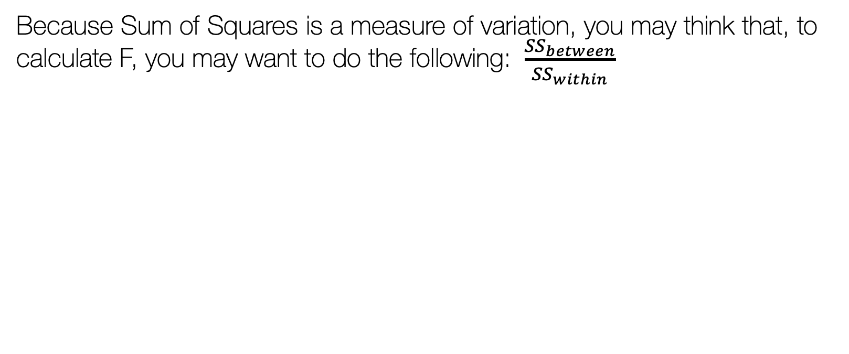
Calculating Anova (F )
Because Sum of Squares is a measure of variation, you may think that, to calculate F, you may want to do the following: $\frac{{SS}_{between}}{{SS}_{within}}$
Notes:
A more “pure” measure of variation

Slide 25
Calculating Anova (F )
But… Sum of Squares increases as sample size increases, so number will be HUGE with increased numbers of cases
To fix, need to adjust Sum of Squares by controlling for the number of scores included in the calculations
Divide each Sum of Squares by the degrees of freedom
This is known as the Mean Square
Notes:
A more “pure” measure of variation

Slide 26
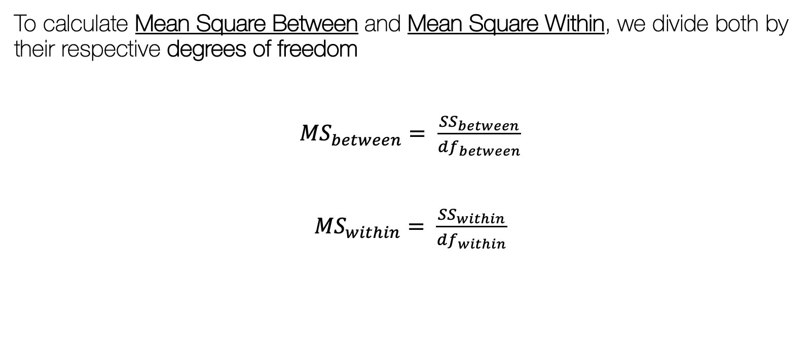
Calculating Anova (F )
To calculate Mean Square Between and Mean Square Within, we divide both by their respective degrees of freedom
${MS}_{between}= \frac{{SS}_{between}}{{df}_{between}}$
${MS}_{within}= \frac{{SS}_{within}}{{df}_{within}}$
Notes:
A more “pure” measure of variation

Slide 27
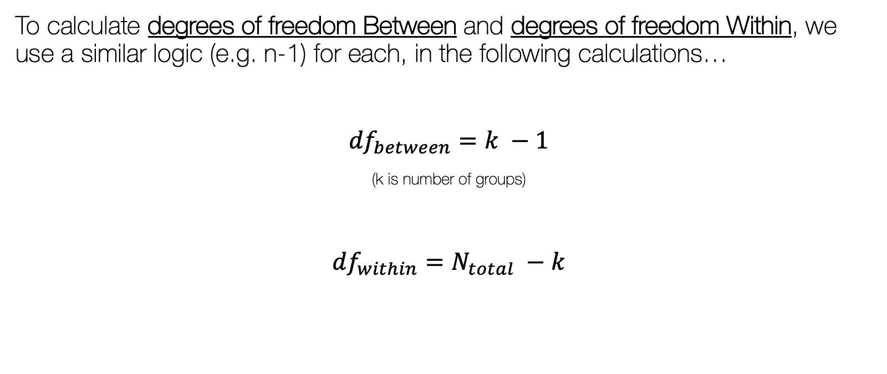
Calculating Anova (F )
To calculate degrees of freedom Between and degrees of freedom Within, we use a similar logic (e.g. n-1) for each, in the following calculations…
${df}_{between}=k −1$
(k is number of groups)
${df}_{within}=N_{total} −k$
Notes:
A more “pure” measure of variation

Slide 28
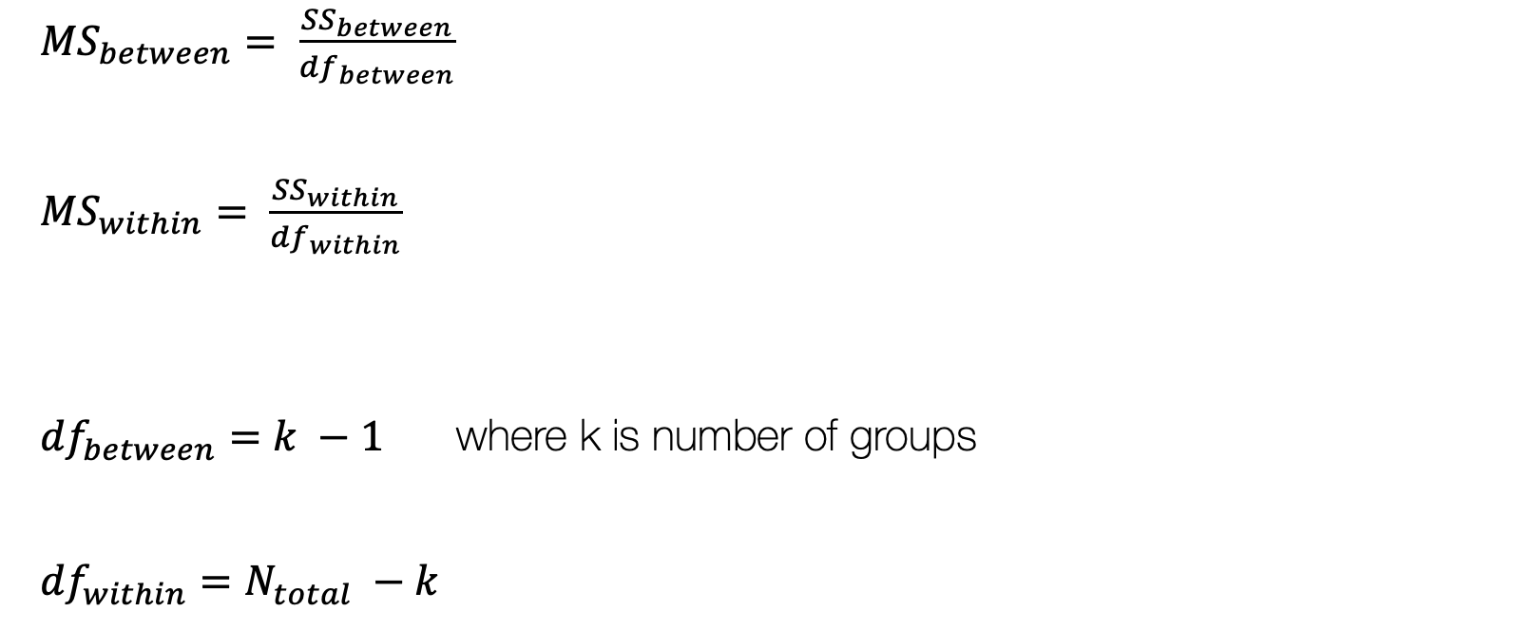
Calculating Anova (F )
${MS}_{between}= \frac{{SS}_{between}}{{df}_{between}}$
${MS}_{within}= \frac{{SS}_{within}}{{df}_{within}}$
${df}_{between}=k −1$ where k is number of groups
${df}_{within}=N_{total} −k$

Slide 29
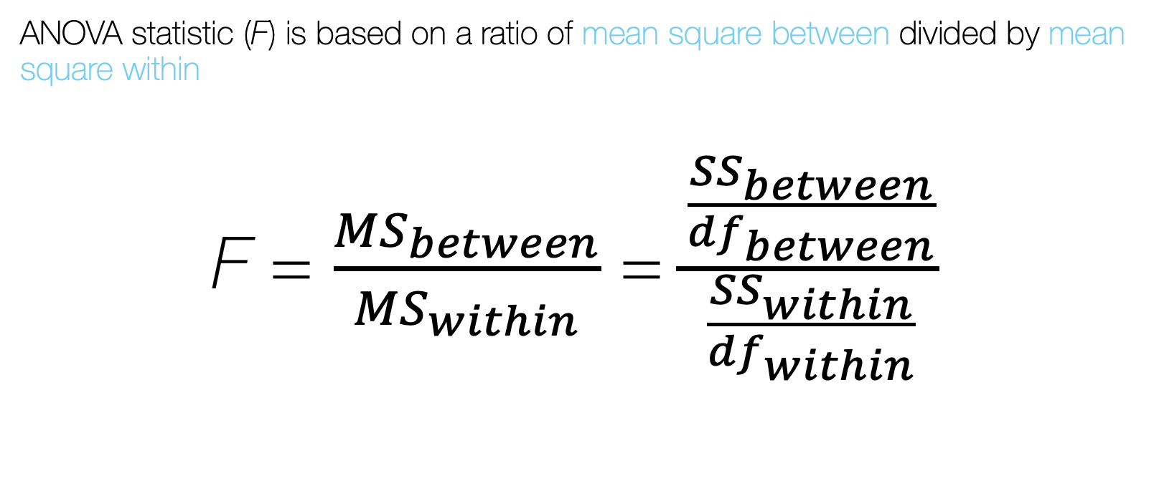
Calculating Anova (F )
ANOVA statistic (F) is based on a ratio of mean square between divided by mean square within
F = $\frac{{MS}_{between}}{{MS}_{within}}$ = $\frac{\frac{{SS}_{between}}{{df}_{between}}}{\frac{{SS}_{within}}{{df}_{within}}}$

Slide 30
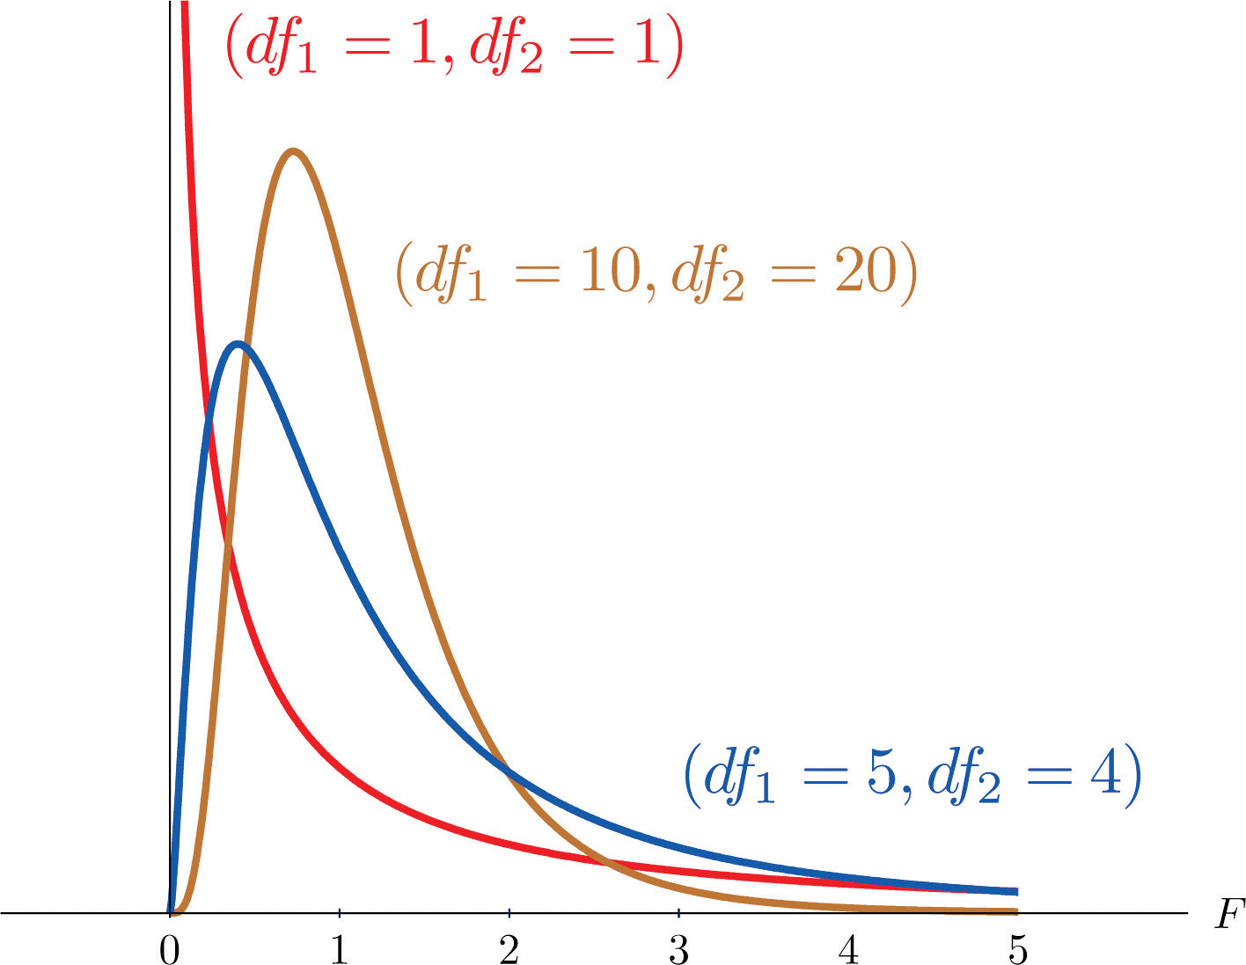
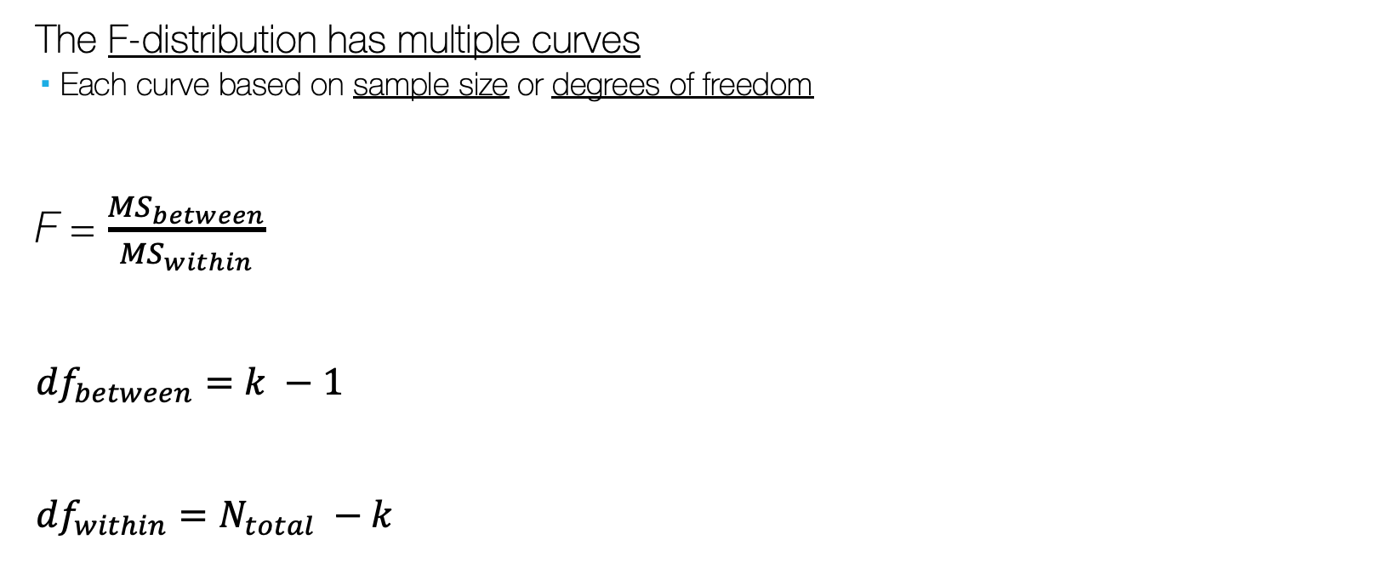
F-Test and the F-distribution
The F-distribution has multiple curves
Each curve based on sample size or degrees of freedom
F = $\frac{{MS}_{between}}{{MS}_{within}}$
${df}_{between}=k −1$
${df}_{within}=N_{total} −k$

Slide 31
Hypothesis Testing with ANOVA
Is the variation (difference) between group means “extremely” distinct from what is expected by chance/the null hypothesis?

Slide 32

Is the F extreme?
Recall the t-Test:
If | t_{obtained} | $≥$ | t_{critical} | , then…
Difference between mean of group 1 and mean of group 2 is so extreme that we can’t blame it on sampling error, therefore… H₀ is probably not true, so…
t_{obtained} is in rejection region
Reject H₀
p $≤α$
Statistically significant difference

Slide 33

Is the F extreme?
Similar for F:
If | F_{obtained} | $≥$ | F_{critical} | , then…
Overall differences between group means is so extreme that we can’t blame it on sampling error, therefore… H₀ is probably not true, so…
F_{obtained} is in rejection region
Reject H₀
p $≤α$
Statistically significant difference between group means

Slide 34
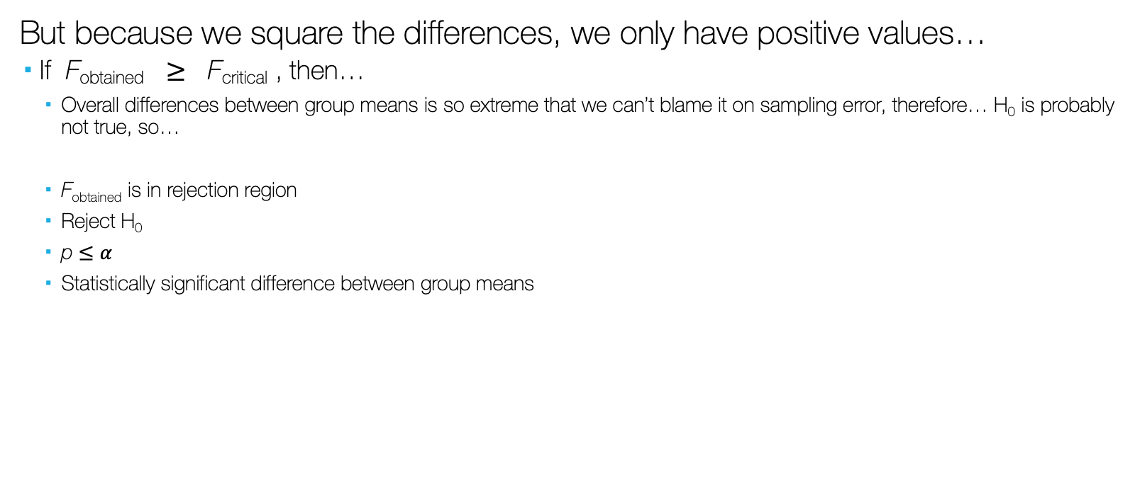
Is the F extreme?
But because we square the differences, we only have positive values…
If F_{obtained} $≥$ F_{critical} , then…
Overall differences between group means is so extreme that we can’t blame it on sampling error, therefore… H₀ is probably not true, so…
F_{obtained} is in rejection region
Reject H₀
p $≤α$
Statistically significant difference between group means

Slide 35
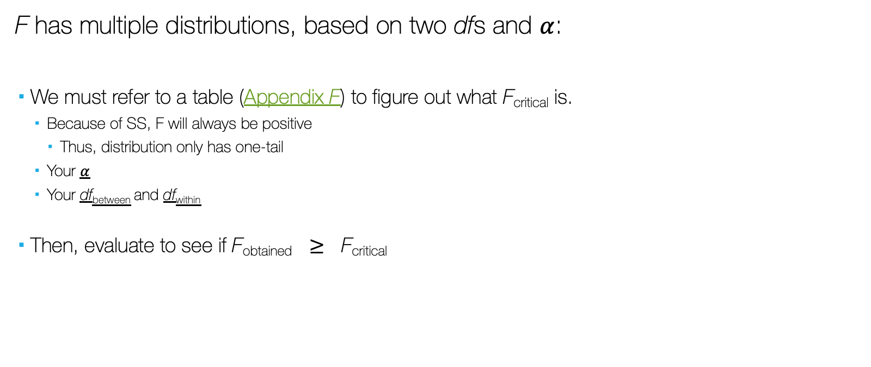
Is the F extreme?
F has multiple distributions, based on two dfs and $α$:
We must refer to a table (Appendix F) to figure out what F_{critical} is.
Because of SS, F will always be positive
Thus, distribution only has one-tail
Your $α$
Your df_{between} and df_{within}
Then, evaluate to see if F_{obtained} $≥$ F_{critical}

Slide 36
Is the F extreme?
Choose a table to use in Appendix F based on our alpha level (α = .05 or α = .01)
Select the column associated with our df_{between} (numerator) value and the row associated with our df_{within} (denominator) value, we find the value that intersects both.
This is our critical F.
If our obtained F is larger than the critical F, we know our obtained F is significant (at least at the table’s α level, or p=.05)

Slide 37
Reporting ANOVA (F)
Report
The test used
If you reject or fail to reject the null hypothesis
The variables used in the analysis
The degrees of freedom, calculated value of the test, and p-value
F(df_{between} , df_{within}) = F_{obtained}, p-value
“Using a one-way ANOVA, I reject/fail to reject the null hypothesis that there is no mean difference in dependent variable across groups of the independent variable, in the population F(?,?) = ?, p ? .05”

Slide 38
Example: Monthly Income by Race
Does income (dollars per month) vary by race?
Is there a significant difference between mean monthly income for people of different racial categories?
Black, White, Latinx, Other

Slide 39
Example: Monthly Income by Race
Race | Income
black | 3670
black | 3132
black | 3798
black | 3929
black | 3203
white | 6628
white | 4702
white | 4264
white | 4063
white | 4847
latinx | 2239
latinx | 3143
latinx | 4580
latinx | 3158
latinx | 3471
other | 3131
other | 4462
other | 3901
other | 3410
other | 4927

Slide 40

Example: Monthly Income by Race
Race | Income
black | 3670
black | 3132
black | 3798
black | 3929
black | 3203
white | 6628
white | 4702
white | 4264
white | 4063
white | 4847
latinx | 2239
latinx | 3143
latinx | 4580
latinx | 3158
latinx | 3471
other | 3131
other | 4462
other | 3901
other | 3410
other | 4927
 | black | white | latinx | other
 | 3670 | 6628 | 2239 | 3131
 | 3132 | 4702 | 3143 | 4462
 | 3798 | 4264 | 4580 | 3901
 | 3929 | 4063 | 3158 | 3410
 | 3203 | 4847 | 3471 | 4927
n | 5 | 5 | 5 | 5
group mean | 3546.4 | 4900.8 | 3318.2 | 3966.2
grand mean | 3932.9
$$SSwithin= \sum{{(X −{\overline{X}}_{group})}^{2}}$$
$$SSbetween= \sum{Ngroup{(\overline{X}group −{\overline{X}}_{total})}^{2}}$$
$SStotal={SS}_{between}$ $+ {SS}_{within}$

Slide 41
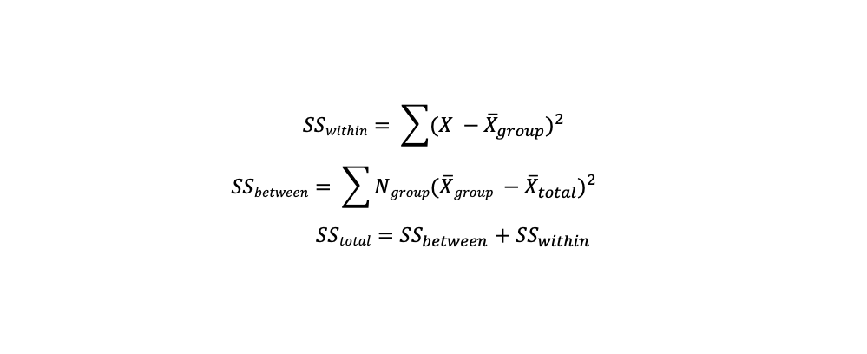
Example: Monthly Income by Race
 | black (X-group mean)^2 | white (X-group mean)^2 | latinx (X-group mean)^2 | other (X-group mean)^2
Within Group SS | 15276.96 | 2983219.84 | 1164672.64 | 697559.04
 | 171727.36 | 39521.44 | 30695.04 | 245817.64
 | 63302.56 | 405514.24 | 1592139.24 | 4251.04
 | 146382.76 | 701908.84 | 25664.04 | 309358.44
 | 117923.56 | 2894.44 | 23347.84 | 923136.64
SS within | 9664313.6
 | black | white | latinx | other
 | 3670 | 6628 | 2239 | 3131
 | 3132 | 4702 | 3143 | 4462
 | 3798 | 4264 | 4580 | 3901
 | 3929 | 4063 | 3158 | 3410
 | 3203 | 4847 | 3471 | 4927
n | 5 | 5 | 5 | 5
group mean | 3546.4 | 4900.8 | 3318.2 | 3966.2
grand mean | 3932.9
 | black (group mean - grand mean)^2 | white (group mean - grand mean)^2 | latinx (group mean - grand mean)^2 | other (group mean - grand mean)^2
Between Group SS | 746911.25 | 4684152.05 | 1889280.45 | 5544.45
SS between | 7325888.2
$$SSwithin= \sum{{(X −{\overline{X}}_{group})}^{2}}$$
$$SSbetween= \sum{Ngroup{(\overline{X}group −{\overline{X}}_{total})}^{2}}$$
$SStotal={SS}_{between}$ $+ {SS}_{within}$

Slide 42
Example: Monthly Income by Race
N_{total} = 20
k = 4
SS_{between} = 7,325,888
SS_{within} = 9,664,314
Notes:
White males, white females, black males, black females

Slide 43
Example: Monthly Income by Race
df_{between} = k - 1 = 4 – 1 = 3
df_{within} = N - k = 20 – 4 = 16
Notes:
White males, white females, black males, black females

Slide 44
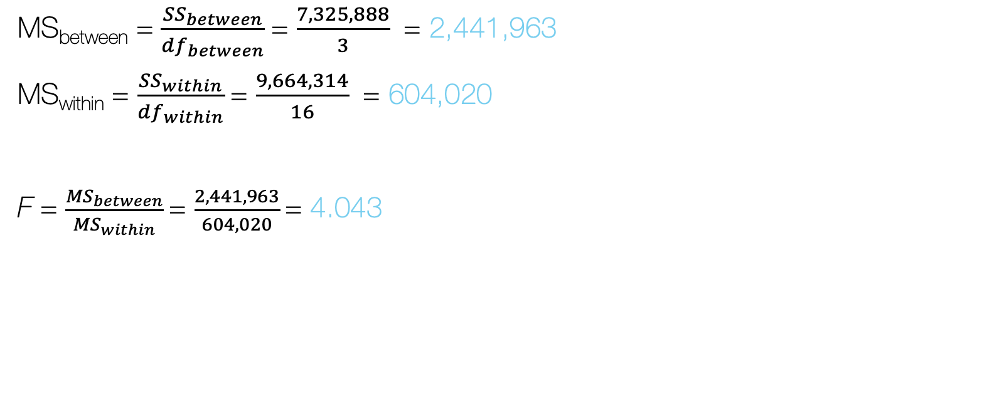
Example: Monthly Income by Race
MS_{between} = $\frac{{SS}_{between}}{{df}_{between}}$= $\frac{7,325,888}{3}$ = 2,441,963
MS_{within} = $\frac{{SS}_{within}}{{df}_{within}}$= $\frac{9,664,314}{16}$ = 604,020
F = $\frac{{MS}_{between}}{{MS}_{within}}$= $\frac{2,441,963}{604,020}$= 4.043

Slide 45
Example: Monthly Income by Race
Using our two df values and our obtained F, we can determine whether our F, representing size of the mean differences between groups, is significant
F_{obtained} = 4.043
df_{between} = 3
df_{within} = 16
In our Appendix F (α = .05), we follow the df_{between} = 3 column and df_{within} = 16 row, we get:
F_{critical} = 3.24

Slide 46
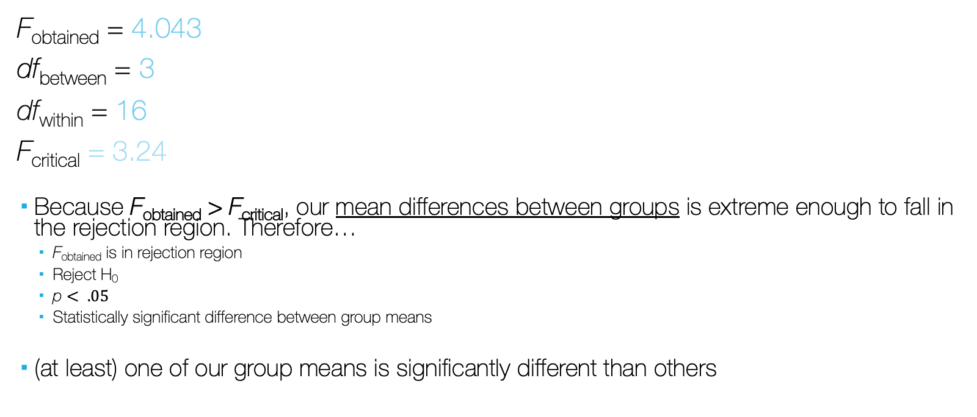
Example: Monthly Income by Race
F_{obtained} = 4.043
df_{between} = 3
df_{within} = 16
F_{critical} = 3.24
Because F_{obtained} > F_{critical}, our mean differences between groups is extreme enough to fall in the rejection region. Therefore…
F_{obtained} is in rejection region
Reject H₀
p $< .05$
Statistically significant difference between group means
(at least) one of our group means is significantly different than others

Slide 47
Example: Monthly Income by Race
Report
The test used
If you reject or fail to reject the null hypothesis
The variables used in the analysis
The degrees of freedom, calculated value of the test, and p-value
F(df_{between} , df_{within}) = F_{obtained}, p-value
“Using a one-way ANOVA, I reject the null hypothesis that there is no mean difference in income across racial categories, in the population F(3,16) = 4.043, p < .05”

Slide 48
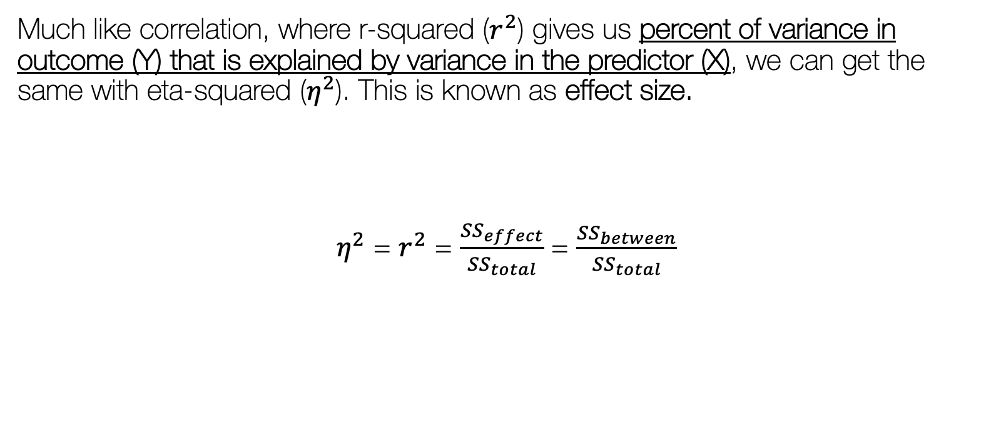
How Much of the Mean difference is explained by Group Membership?
Much like correlation, where r-squared ($r^{2}$) gives us percent of variance in outcome (Y) that is explained by variance in the predictor (X), we can get the same with eta-squared ($η^{2}$). This is known as effect size.
$η^{2}$ = $r^{2}$ = $\frac{{SS}_{effect}}{{SS}_{total}}$ = $\frac{{SS}_{between}}{{SS}_{total}}$

Slide 49
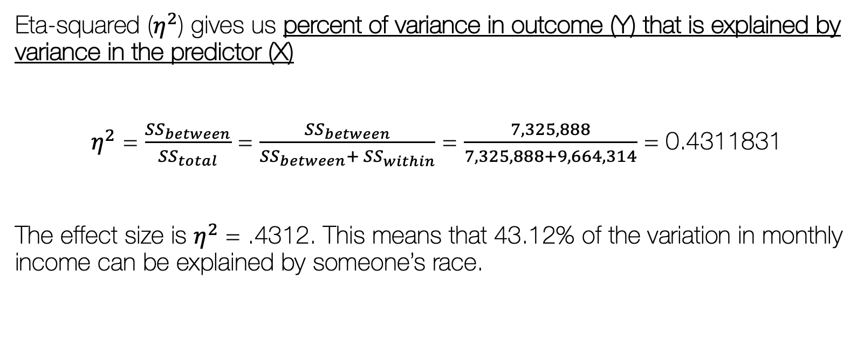
Example: Monthly Income by Race
Eta-squared ($η^{2}$) gives us percent of variance in outcome (Y) that is explained by variance in the predictor (X)
$η^{2}$ = $\frac{{SS}_{between}}{{SS}_{total}}$ = $\frac{{SS}_{between}}{{SS}_{between}+ {SS}_{within}}$ = $\frac{7,325,888}{7,325,888+9,664,314}$ = 0.4311831
The effect size is $η^{2}$ = .4312. This means that 43.12% of the variation in monthly income can be explained by someone’s race.

Slide 50
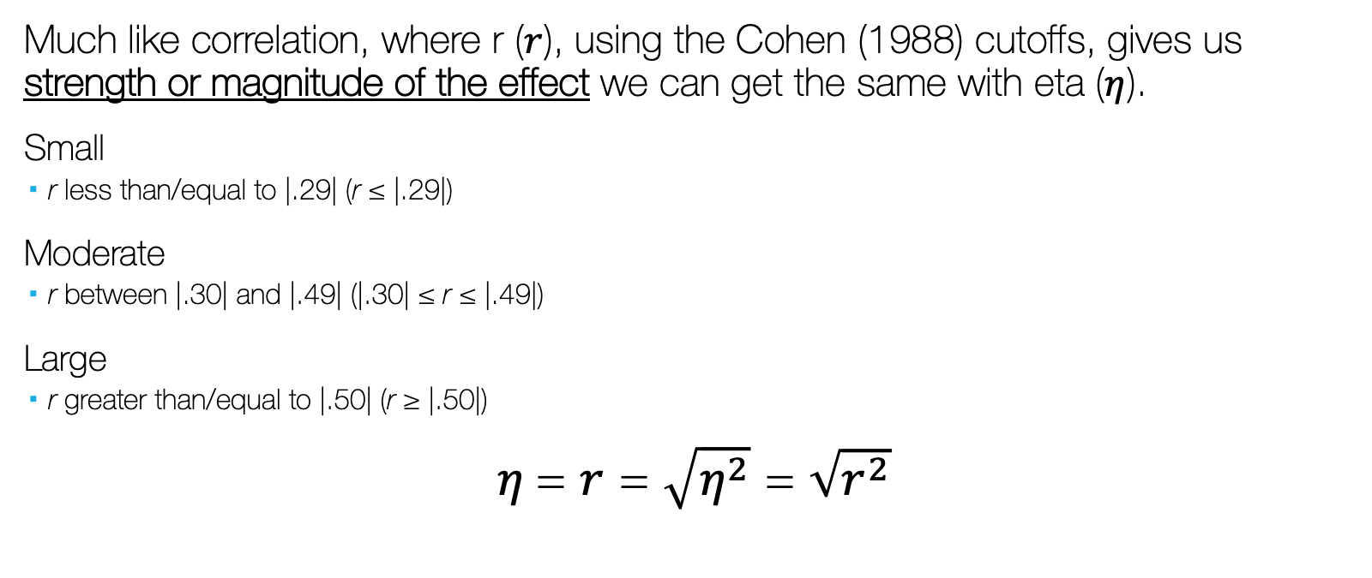
What is the Strength of the effect?
Much like correlation, where r ($r$), using the Cohen (1988) cutoffs, gives us strength or magnitude of the effect we can get the same with eta ($η$).
Small
r less than/equal to |.29| (r ≤ |.29|)
Moderate
r between |.30| and |.49| (|.30| ≤ r ≤ |.49|)
Large
r greater than/equal to |.50| (r ≥ |.50|)
$η$= $r$ = $\sqrt{η^{2}}$ = $\sqrt{r^{2}}$

Slide 51
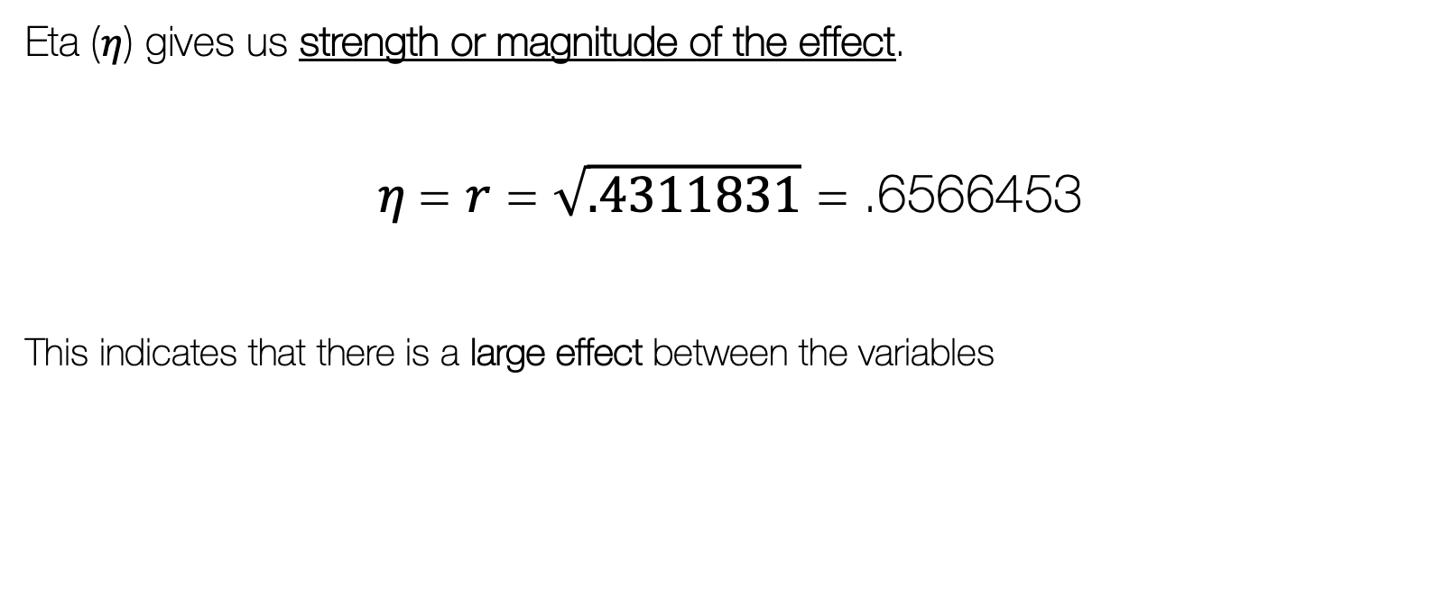
Example: Monthly Income by Race
Eta ($η$) gives us strength or magnitude of the effect.
$η$= $r$ = $\sqrt{.4311831}$ = .6566453
This indicates that there is a large effect between the variables

Slide 52
Significant Differences, Where?
Remember, ANOVA is an omnibus (overall) test of differences
If we find significant F, at least ONE group mean is significantly different than others
It does not mean that every group mean is significantly different from all others.

Slide 53
Significant Differences, Where?
After finding significant F, next step is to identify which group means are significantly different others

Slide 54
Significant Differences, Where?
Plotting means will help identify where differences lie

Slide 55
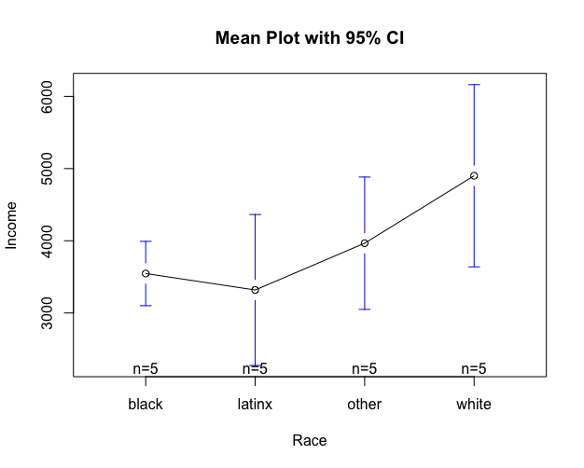
Example: Monthly Income by Race
Plotting means will help identify where differences lie

Slide 56
Significant Differences, Where?
Planned Comparisons/Multiple Comparison Procedures:
Conducting a series of t-tests (mean comparisons) to see where the true mean differences lie

Slide 57
Significant Differences, Where?
Can run many t-tests (two-group comparisons)… but run into the same problem… increasing alpha/Type I error.

Slide 58
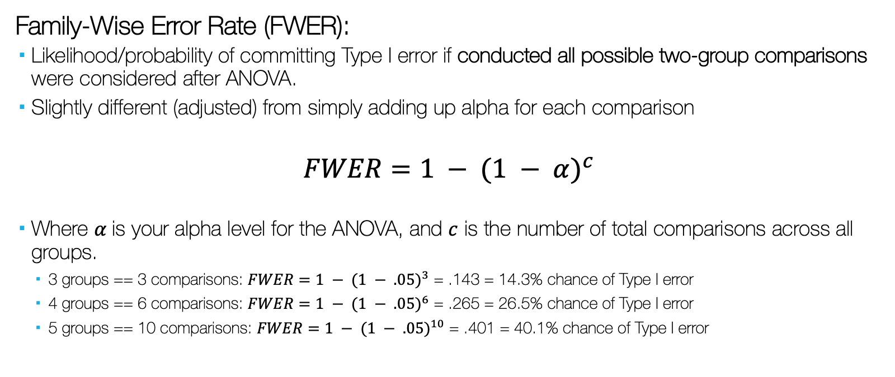
Significant Differences, Where?
Family-Wise Error Rate (FWER):
Likelihood/probability of committing Type I error if conducted all possible two-group comparisons were considered after ANOVA.
Slightly different (adjusted) from simply adding up alpha for each comparison
$$FWER=1 − {(1 − α)}^{c}$$
Where $α$is your alpha level for the ANOVA, and $c$ is the number of total comparisons across all groups.
3 groups == 3 comparisons: $FWER=1 − {(1 − .05)}^{3}$ = .143 = 14.3% chance of Type I error
4 groups == 6 comparisons: $FWER=1 − {(1 − .05)}^{6}$ = .265 = 26.5% chance of Type I error
5 groups == 10 comparisons: $FWER=1 − {(1 − .05)}^{10}$ = .401 = 40.1% chance of Type I error

Slide 59
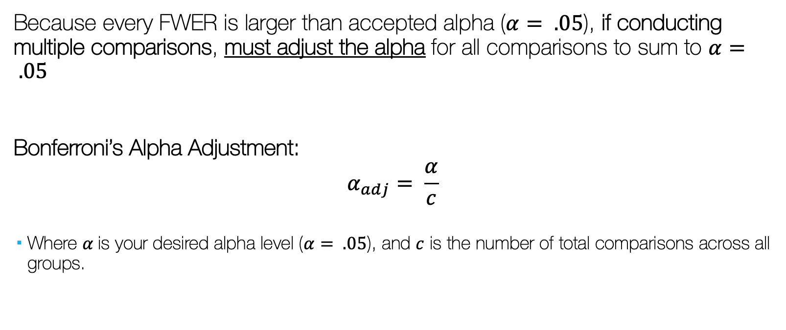
Significant Differences, Where?
Because every FWER is larger than accepted alpha ($α= .05$), if conducting multiple comparisons, must adjust the alpha for all comparisons to sum to $α= .05$
Bonferroni’s Alpha Adjustment:
$$α_{adj}= \frac{α}{c}$$
Where $α$is your desired alpha level ($α= .05$), and $c$ is the number of total comparisons across all groups.

Slide 60
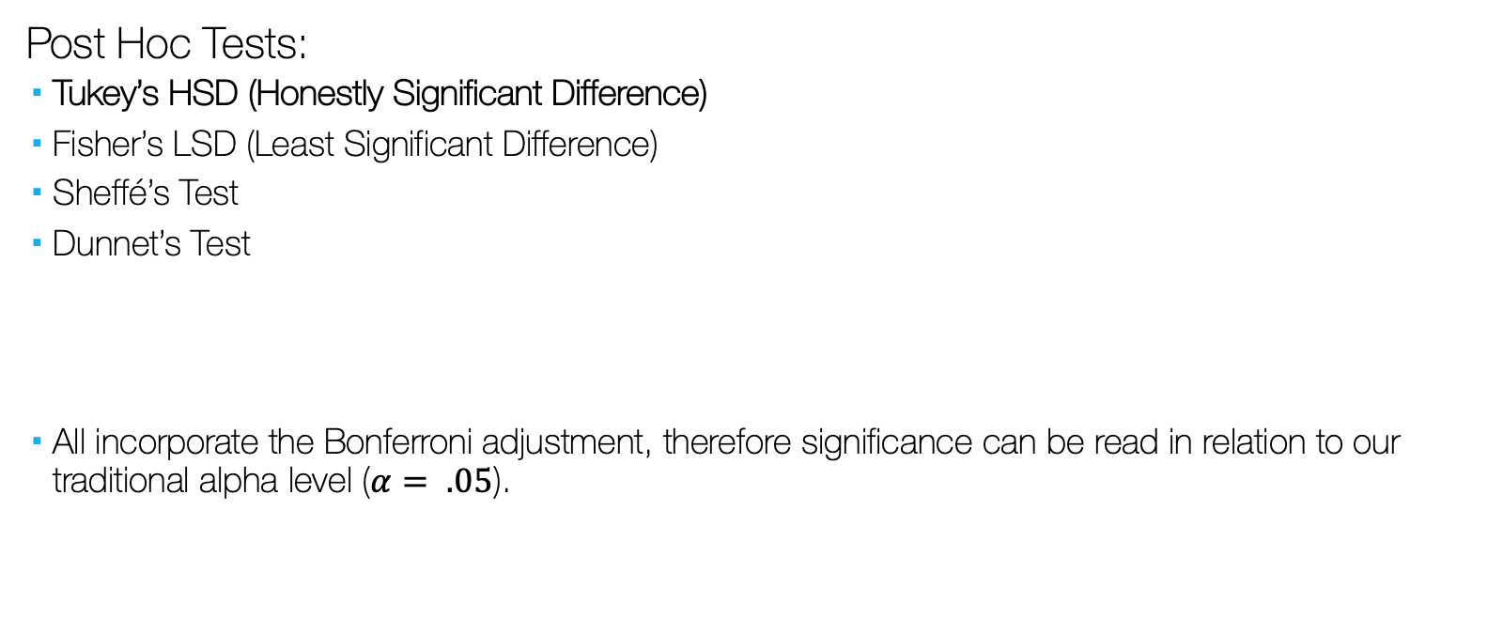
Significant Differences, Where?
Post Hoc Tests:
Tukey’s HSD (Honestly Significant Difference)
Fisher’s LSD (Least Significant Difference)
Sheffé’s Test
Dunnet’s Test
All incorporate the Bonferroni adjustment, therefore significance can be read in relation to our traditional alpha level ($α= .05$).

Slide 61
Significant Differences, Where?
Tukey’s HSD
We can see from the results of the Tukey HSD test that the only real difference (or the mean difference that is holding the significant ANOVA) is the comparison between white’s mean income and latinx’ mean income.
Group | Difference | p (adjusted)
latinx-black | -228.2 | 0.9657923
other-black | 419.8 | 0.8279317
white-black | 1354.4 | 0.0611291
other-latinx | 648 | 0.5651327
white-latinx | 1582.6 | 0.0248001
white-other | 934.6 | 0.2662779

